Slide 1

Artificial Intelligence and Humour
Shaunak Chhaparia (07005019)
Vivek Jhunjhunwala (07005028)
Kunal Mittal (07D05001)
Shashank Dabriwal (07D05012)
Aman Gothwal (05D05007)

Slide 2


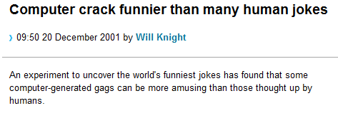


Motivation
The use of humour is a complex and puzzling human behaviour and hence is of scientific interest.
http://www.newscientist.com/article/dn1719-computer-crack-funnier-than-many-human-jokes.html
http://farm4.static.flickr.com/3262/2921908163_e04648c391_o.jpg

Slide 3
Contents
1 ☺ Introduction
2 ☺ Theories on Humour
3 ☺ Linguistic Research on Humour
4 ☺ Computational Humour
Humour Recognition
Humour Generation
5 ☺ Applications
6 ☺ Conclusions

Slide 4

1 ☺ Introduction

Slide 5
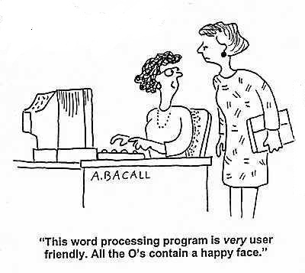

Introduction
"Humour is a very interesting way to look at artificial intelligence because at some point something has to have two meanings, which is not easy to do with a computer." – Jason Rutter, Manchester University.
http://www.cartoonstock.com/cartoonview.asp?catref=aba0021
Humor is something that thrives between man's aspirations and his limitations. There is more logic in humour than in anything else. Because, you see, humour is truth. ~Victor Borge, London Times, 3 January 1984

Slide 6
2 ☺ Theories on Humour

Slide 7
Superiority Theory
Traces back to Plato and Aristotle
A person laughs about the misfortunes of others
A person asserts his superiority on the background of shortcomings of others
Example:
A man spoke frantically into the phone, "My wife is pregnant and her contractions are only two minutes apart!”
"Is this her first child?" the doctor asked.
"No, you idiot!" the man shouted. "This is her husband!”
Basically, superiority jokes poke fun, and they poke at someone else to do it.
"Nothing produces laughter more than a surprising disproportion between that which one expects and that which one sees.“ – Blaise Pascal (17th Century A.D.)

Slide 8
Relief or Release Theory
Sigmund Freud and Herbert Spencer prominent theorists
Joke about things which make people unsure/uncomfortable
Jokes about religion, politics, sex, ethnic differences
Release of tension and psychic energy
Example:
(To Shaunak) Give reasons whether a computer is a male or a female?
Shaunak: Female, reasons:
No one but the Creator understands their internal logic.
Even your smallest mistakes are stored in long term memory for later retrieval.
Tragedy + Time = Humour (Anonymous)

Slide 9
Incongruity Theory
A leading approach, has its origin in comments made by Aristotle in Rhetoric
The joke has two parts : setup & punch line
Joke generation due to disagreement in parts
Main point is not incongruity but realization and resolution
Example:
I said to the Gym instructor: “Can you teach me to do the splits?”
He said: “How flexible are you?”
I said: “I can't make Tuesdays and Fridays.”
The secret to humour is surprise – Aristotle

Slide 10
3 ☺ Linguistic Research on Humour

Slide 11
Semantic Script-Based Theory of Humour (SSTH)
Jokes based on script opposition, an idea closely related to incongruity
Joke is humorous if two conditions are satisfied:
Humorous text has to be compatible with two different scripts (interpretations)
Two interpretations have to oppose each other
Example:
The first thing that ‘strikes’ a stranger in New York is a big car

Slide 12
General Theory of Verbal Humour (GTVH)
Script Recognition (knowledge source based on opposing interpretations)
Logical Mechanism (possible resolution mechanism for the incongruity)
Situation (context of joke, location, participants)
Target (person/group targeted by the joke)
Narrative Strategy (style – riddle, dialogue)
Language (lexicon, syntax, semantics)

Slide 13
General Theory of Verbal Humour (GTVH)
Example: How many poles does it take to screw in a light bulb? Five. One to hold the light bulb and four to turn the table he is standing on.
Script Recognition: dumb resolution, proposed by punch line
Logical Mechanism: reversal of normal behaviour
Situation: bulb changing
Target: poles
Narrative Strategy: riddle

Slide 14
4 ☺ Computational Humour

Slide 15
Computational Humour
The branch of computer linguistics and AI that uses computers in Humour Research
Humour Recognition
Humour Generation
JAPE
Pun Generation
HAHAcronym

Slide 16
Humour Recognition
Humour specific stylistic features
Alliteration: Structural and phonetic properties of joke
Example : Veni Vidi Visa: ‘I’ came, ‘I’ saw, ‘I’ did a little shopping.
Identify and count the no. of alliterations/ rhyme chain in our e.g.
Antonymy: Incongruity, opposition, apparent contradiction
Example: Always try to be modest and be proud of it!
Identified using WordNet and similar-to antonymy relation among parts of speech
Adult Slang: Based on adult slang, popular
Example: Artificial Insemination: procreation without recreation
Extract from WordNet Domains, all the synsets labelled with domain SEXUALITY

Slide 17
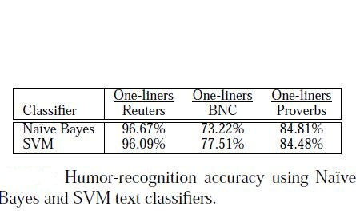
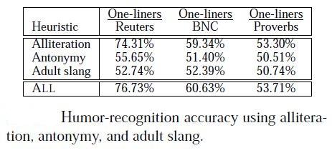
Humour Recognition
Content based learning: general text classification problem
Naive Bayes: estimate category of a document using joint probabilities of words and documents
Support Vector Machines: binary classifiers which find hyper-plane that best separates a set of +ve examples from a set of –ve ones.
* Reference [5]
* Reference [5]

Slide 18
JAPE Joke Analysis and Production Engine (joke generator)
Graeme Ritchie and Kim Binsted in 1994 described a computer program, JAPE, designed to generate question-answer-type puns from a general, non-humorous lexicon
A riddle generator capable of producing simple punning riddles
Natural decomposition into a set-up and a punch line
With a set of symbolic rules about suitable meaning combinations and textual forms and also a large natural language lexicon, it can produce Q&A puns

Slide 19
JAPE: Example
Question: What kind of a murderer has a moral fibre?
Processing:
Murderer is a killer
Fibre is present in food
Cereal is also a food
Cereal sounds like serial (Phonological punning component)
Serial-killer makes a meaningful phrase
Answer: A cereal killer!

Slide 20
Pun Generation
Pun generation usually uses the inherent ambiguity in the linguistics
Homophonic Pun:
Exploits word pairs that sound alike
This is done by syllable substitution (confuse syllables in a word), word substitution (confuse entire word), metathesis (reversal of sounds and words).
Metathesis Example: What is the difference between a torn flag and a postage stamp? One’s a tattered banner and the other’s a battered tanner!

Slide 21
Pun Generation
Homographic Pun:
Exploits different words or word meanings which are spelt the same way but possess different meanings
Example: "pen" for writing instrument or animal enclosure
Homographic puns using words with the same spelling but different pronunciations are called ‘heteronymic’ pun
Example: You can “tune a” guitar, but you can't “tuna” fish. Unless of course, you play “bass”.

Slide 22
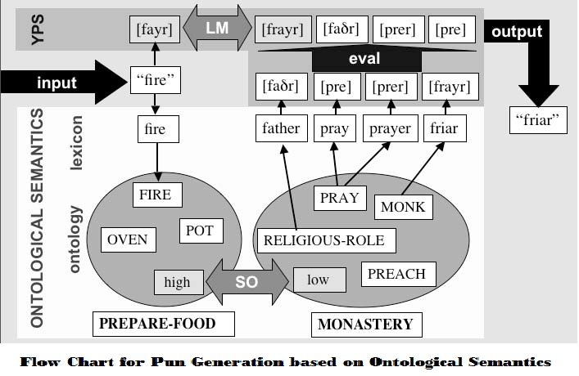
Pun Generation: Example
What did the egg say in the monastery?
Out of the frying pan, into the friar.
* Reference [2]

Slide 23
HAHAcronym
First European project devoted to computational humour
Aim to automatically generate humorous versions of existing acronyms or to produce new amusing acronyms constrained to be a valid vocabulary word
Examples:
CBI : Cheapest Bureau of Intimidation
FAINT : Folksy Acritical Instruction for Nescience Teaching
IIT : Institute of Infinite Tension ☺

Slide 24
HAHAcronym: Implementation
Algorithm Schema:
Acronym parsing and construction of a logical form
Choice of what to keep unchanged and what to modify (adjectives)
Look for possible initial letter preserving, substitutions
Resources/methods used:
WordNet domains, domain labels
Independent structure of domain opposition to generate incongruity
Acronyms, grammars, rhyming dictionaries, proper noun databases

Slide 25
5 ☺ Applications

Slide 26
Applications
Use as a humour generator (e.g. JAPE, HAHAcronym), humour understander, humour appreciator
Generation of chat bots, so that computer can become social actors
Designing better human-computer interactive systems; humour generation in user interface to ease communication
Integration of one-liners into email applications
For educational purposes: riddles to improve text comprehension in small children
Humour can help make clarification queries less repetitive,
statements of ignorance more acceptable and error
messages less patronizing…….

Slide 27
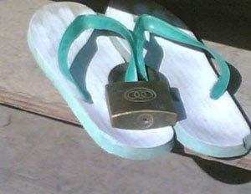
Other Aspects of Humour
We have focussed mainly on “verbal humour,” which is the most tangible and perhaps the most widely researched form of humour.
Although there are other forms of humour too – visual, situational
Visual :
Situational : demo ☺ (F.R.I.E.N.D.S.) ☺

Slide 28

DEMO
F.R.I.E.N.D.S. Demo Video

Slide 29
6 ☺ Conclusions

Slide 30
Conclusions
AI and scope of humour
Designing better human-computer interaction system
Humar recognition, generation and appreciation
We still have to develop sufficient understanding of humour and of human behaviour to permit even limited forms of jokes to lubricate human computer interface
There is still a long way to go for machines to turn into virtual humans!!
I regard the writing of humour as a supreme artistic challenge (Herman Wouk)

Slide 31
References
Ritchie, G. 2001. Current Directions in Computational Humour. Artif. Intell. Rev. 16, 2 (Oct. 2001), 119-135. DOI= http://dx.doi.org/10.1023/A:1011610210506
Christian F. Hempelmann, Victor Raskin and Katrina E. Triezenberg. “Computer, Tell Me a Joke ... but Please Make it Funny: Computational Humor with Ontological Semantics.” In: Russell, Ingrid and Zdravko Markov. Eds. Proceedings of the 18th International Florida Artificial Intelligence Research Society. Menlo Park, CA: AAAI Press. 2006: 746-751.
Stock, O. and Strapparava, C. 2005. HAHAcronym: a computational humor system. In Proceedings of the ACL 2005 on interactive Poster and Demonstration Sessions (Ann Arbor, Michigan, June 25 - 30, 2005). Annual Meeting of the ACL. Association for Computational Linguistics, Morristown, NJ, 113-116. DOI= http://dx.doi.org/10.3115/1225753.1225782
Mihalcea, R. 2007. The Multidisciplinary Facets of Research on Humour. In Proceedings of the 7th international Workshop on Fuzzy Logic and Applications: Applications of Fuzzy Sets theory (Camogli, Italy, July 07 - 10, 2007). F. Masulli, S. Mitra, and G. Pasi, Eds. Lecture Notes In Artificial Intelligence, vol. 4578. Springer-Verlag, Berlin, Heidelberg, 412-421. DOI= http://dx.doi.org/10.1007/978-3-540-73400-0_52
Mihalcea, R. and Strapparava, C. 2005. Making computers laugh: investigations in automatic humor recognition. In Proceedings of the Conference on Human Language Technology and Empirical Methods in Natural Language Processing (Vancouver, British Columbia, Canada, October 06 - 08, 2005). Human Language Technology Conference. Association for Computational Linguistics, Morristown, NJ, 531-538. DOI= http://dx.doi.org/10.3115/1220575.1220642

Slide 32
References
6. F.R.I.E.N.D.S . – The most humorous TV show ever ☺
7. http://www.newscientist.com/article/dn1719-computer-crack-funnier-than-many-human-jokes.html (Downloaded on 02/04/2010)
8. http://www.aaai.org/Papers/FLAIRS/2006/Flairs06-148.pdf (Downloaded on 31/03/2010)
9. http://en.wikipedia.org/wiki/Computational_humor (Downloaded on 30/03/2010)
10. http://en.wikipedia.org/wiki/Theories_of_humour (Downloaded on 30/03/2010)
11. http://science.jrank.org/pages/9715/Humor-Superiority-Theory.html (Downloaded on 01/04/2010)
12. http://www.helium.com/items/337474-the-superiority-theory-and-its-effect-on-humor (Downloaded on 01/04/2010)
13. http://rhetoriclaughter.blogspot.com/2009/10/relief-theory-part-ii-spencer.html
14. http://en.wikipedia.org/wiki/Pun (Downloaded on 02/04/2010)
15. http://www.iep.utm.edu/humor/ (Downloaded on 02/04/2010)
http://www.doc.ic.ac.uk/~sgc/teaching/projects/pun_generation/ (Downloaded on 01/04/2010)

Slide 33
THANK YOU Questions? ☺

